Slide 1


Classification Assignment
Presented by:
Andrew Adel Labib.
Hussien Amin Abdelhafez.
Phoebe Thabit Wadea.
Sandy Adel Latef.

Slide 2
Business case
Take five fiction books for five different authors,
The model will predict author’s name by giving it any sentence of any five books

Slide 3

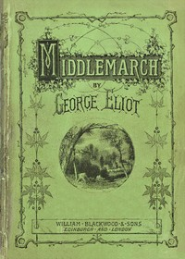

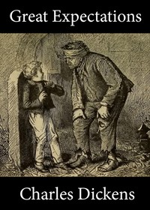
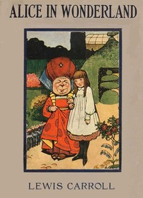
Books

Slide 4
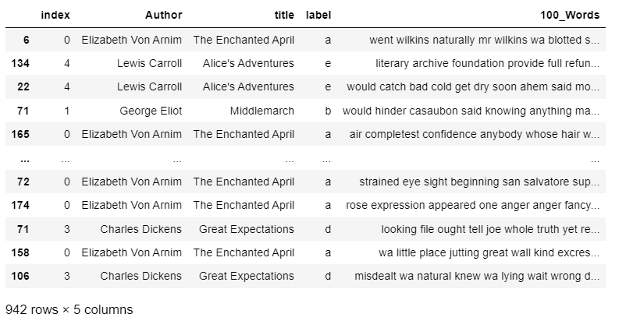
Data preparation result

Slide 5
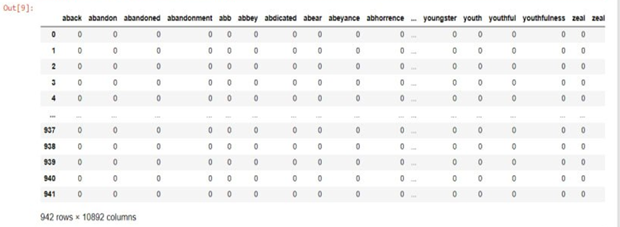
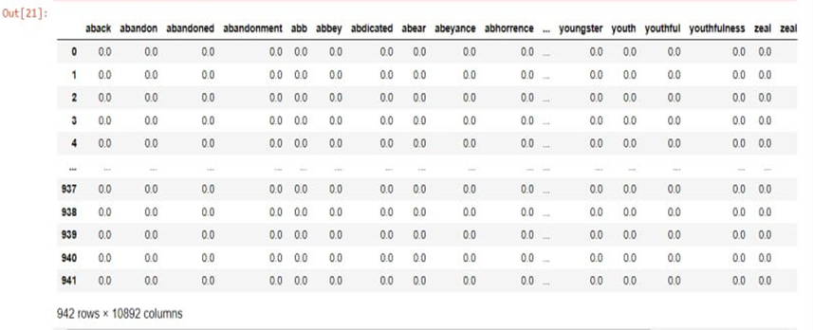
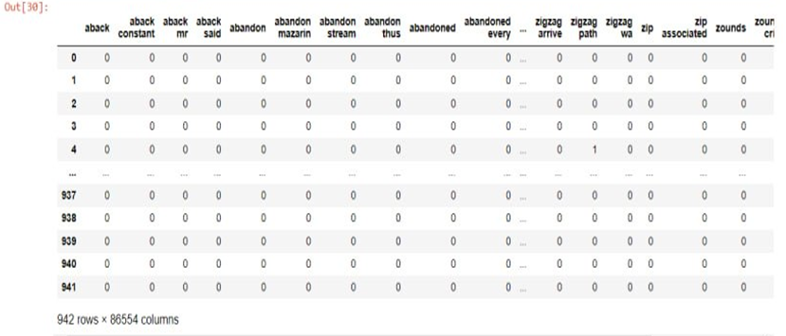
Feature engineering result
BOW
TF-IDF
N-Gram

Slide 6
Classification models
SVM.
Random Forest.
Naïve Bayes.
K-Nearest Neighbour.
XG-Boost.
Stochastic Gradient Descent (SGD).

Slide 7
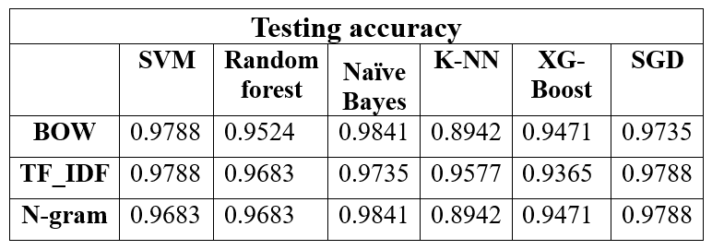
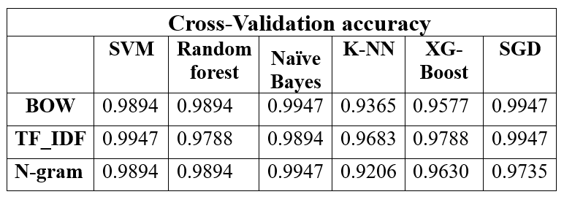
Accuracy result

Slide 8
Champion model
The champion model is: Naïve Bayes based on (N-gram), which gives us the accuracy of 0.9841 (The same accuracy of Naïve Bayes based on BOW) , but the average variance of this model is lower (0.008 (N-gram) < 0.013(BOW)).

Slide 9
Error analysis
Confusion matrix:
Precision, recall, and F1 score
Visualizing misclassified instances

Slide 10
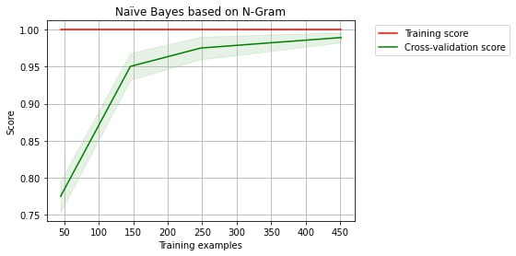
Testing result
Champion model curve :

